Slide 1
9th May Update
Overview
Ambiguous eye annotations
Exploratory Data Analysis

Slide 2
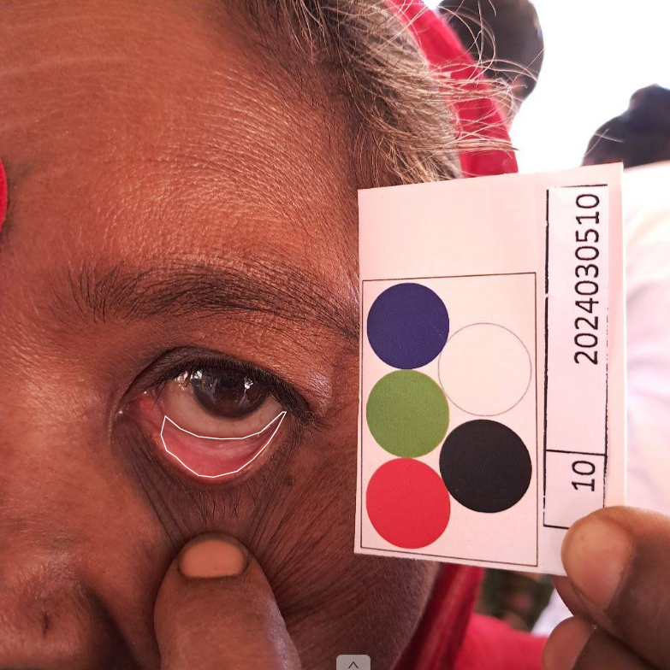
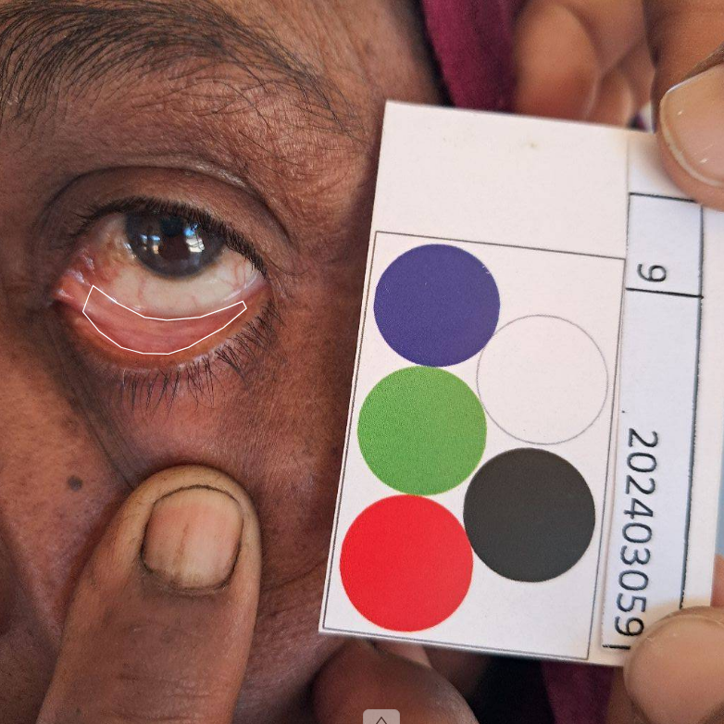
Ambiguous eye annotations
Relatively Good Images

Slide 3
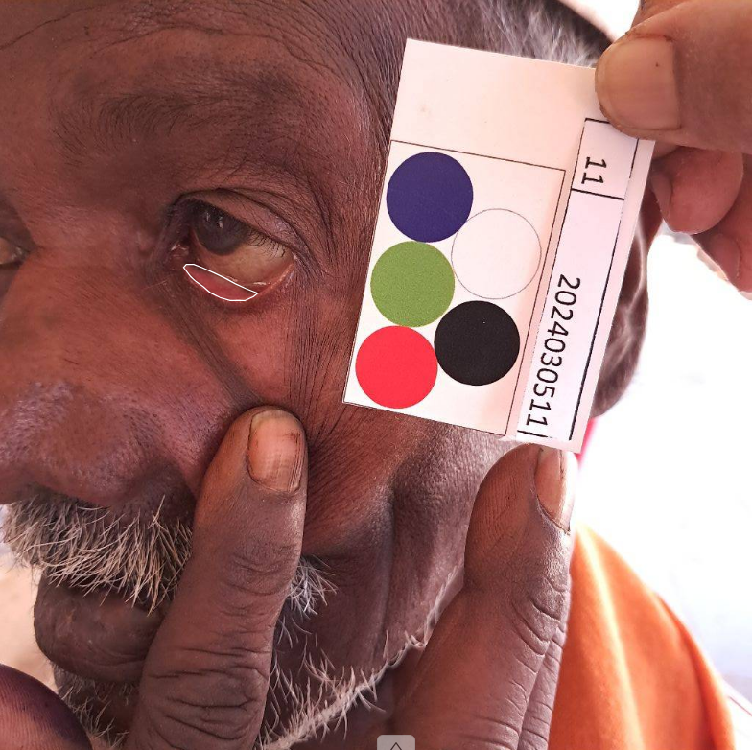
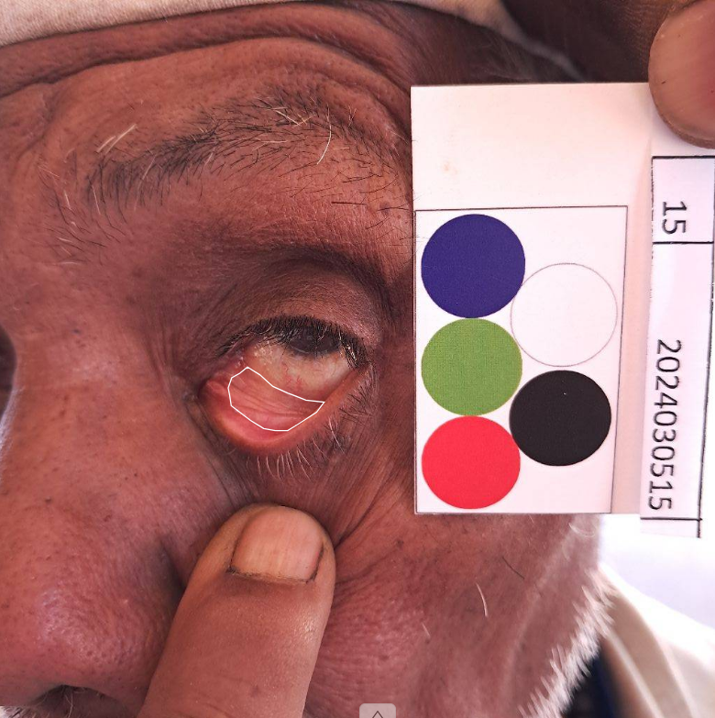
Ambiguous eye annotations
Poor Angle and Ambiguous Images

Slide 4
Left Palm

Slide 5
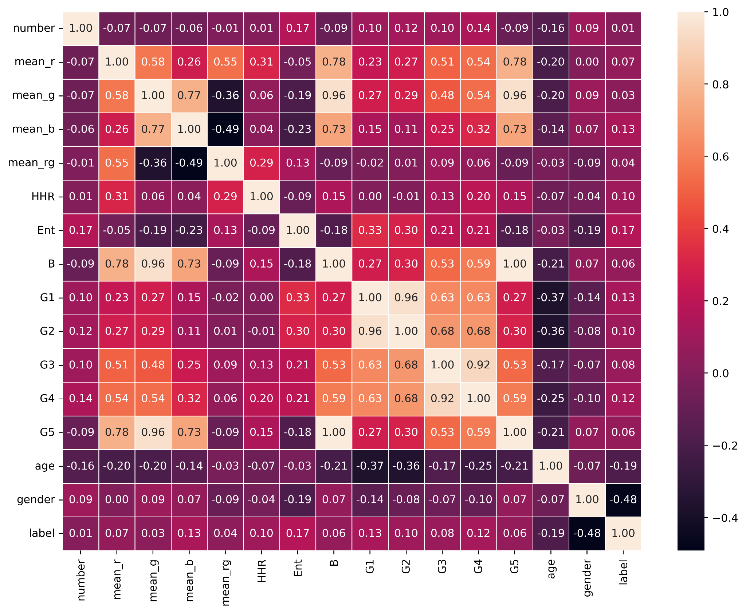
C
O
R
R
E
L
A
T
I
O
N

Slide 6
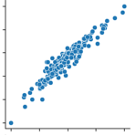
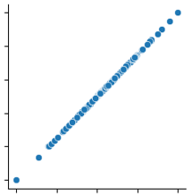
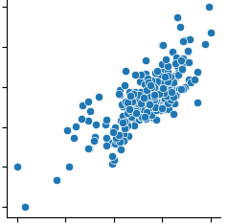
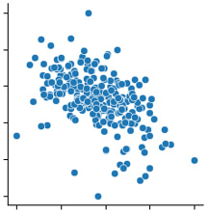
B
B
mean_g
G5
B
mean_rg
mean_b
mean_r

Slide 7
Right Fingernail

Slide 8
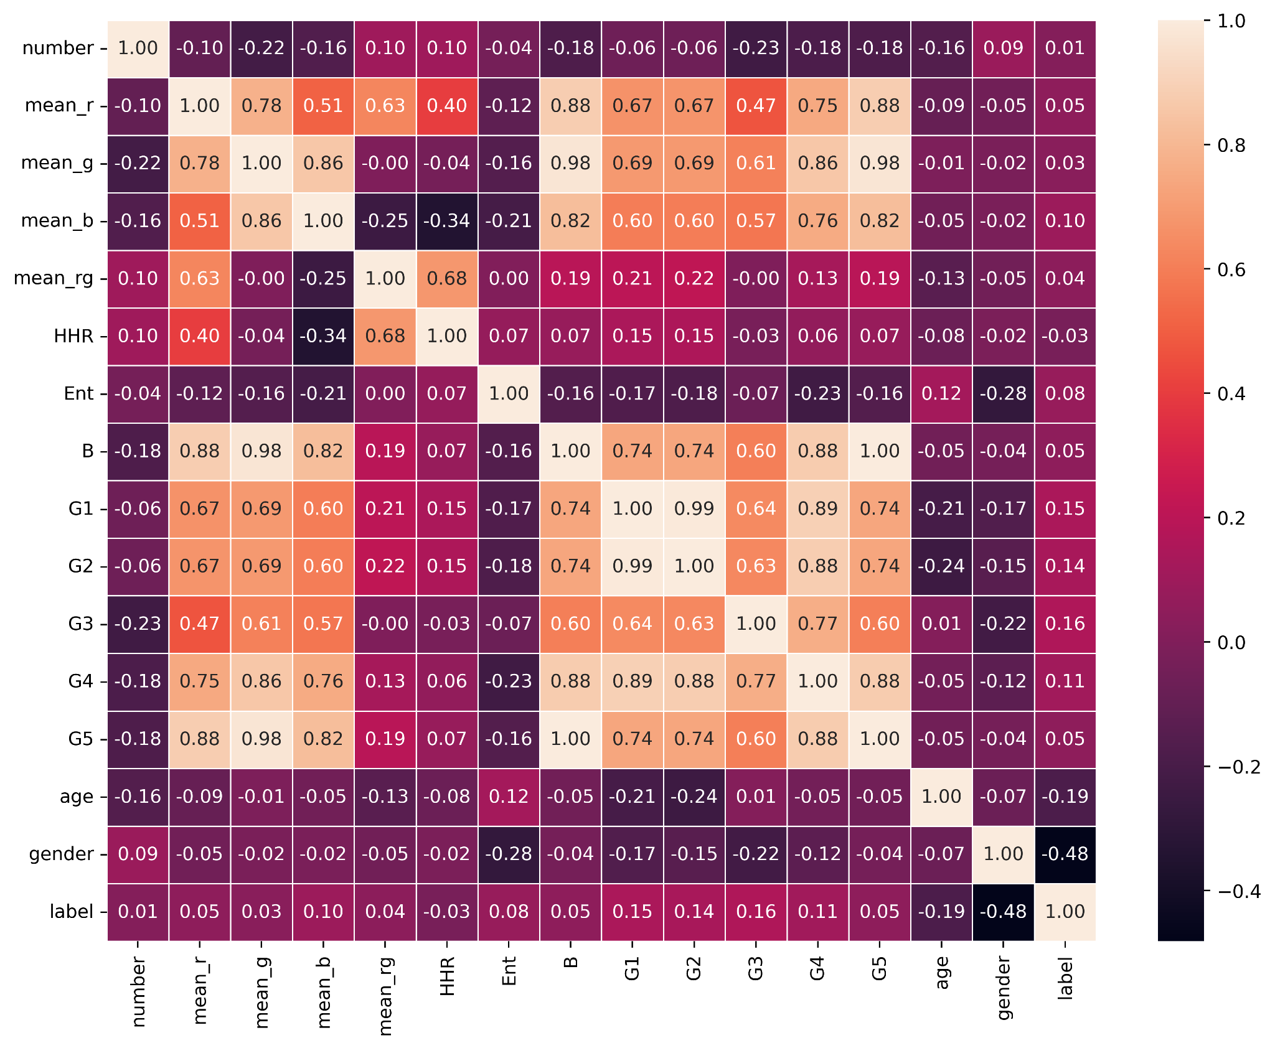
C
O
R
R
E
L
A
T
I
O
N

Slide 9
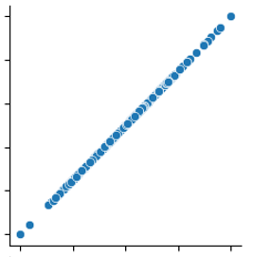
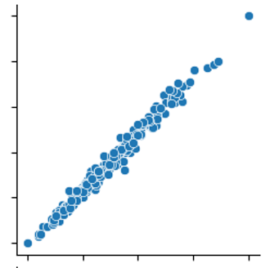
B
G1
G5
G2
G5
mean_g

Slide 10
Tongue

Slide 11
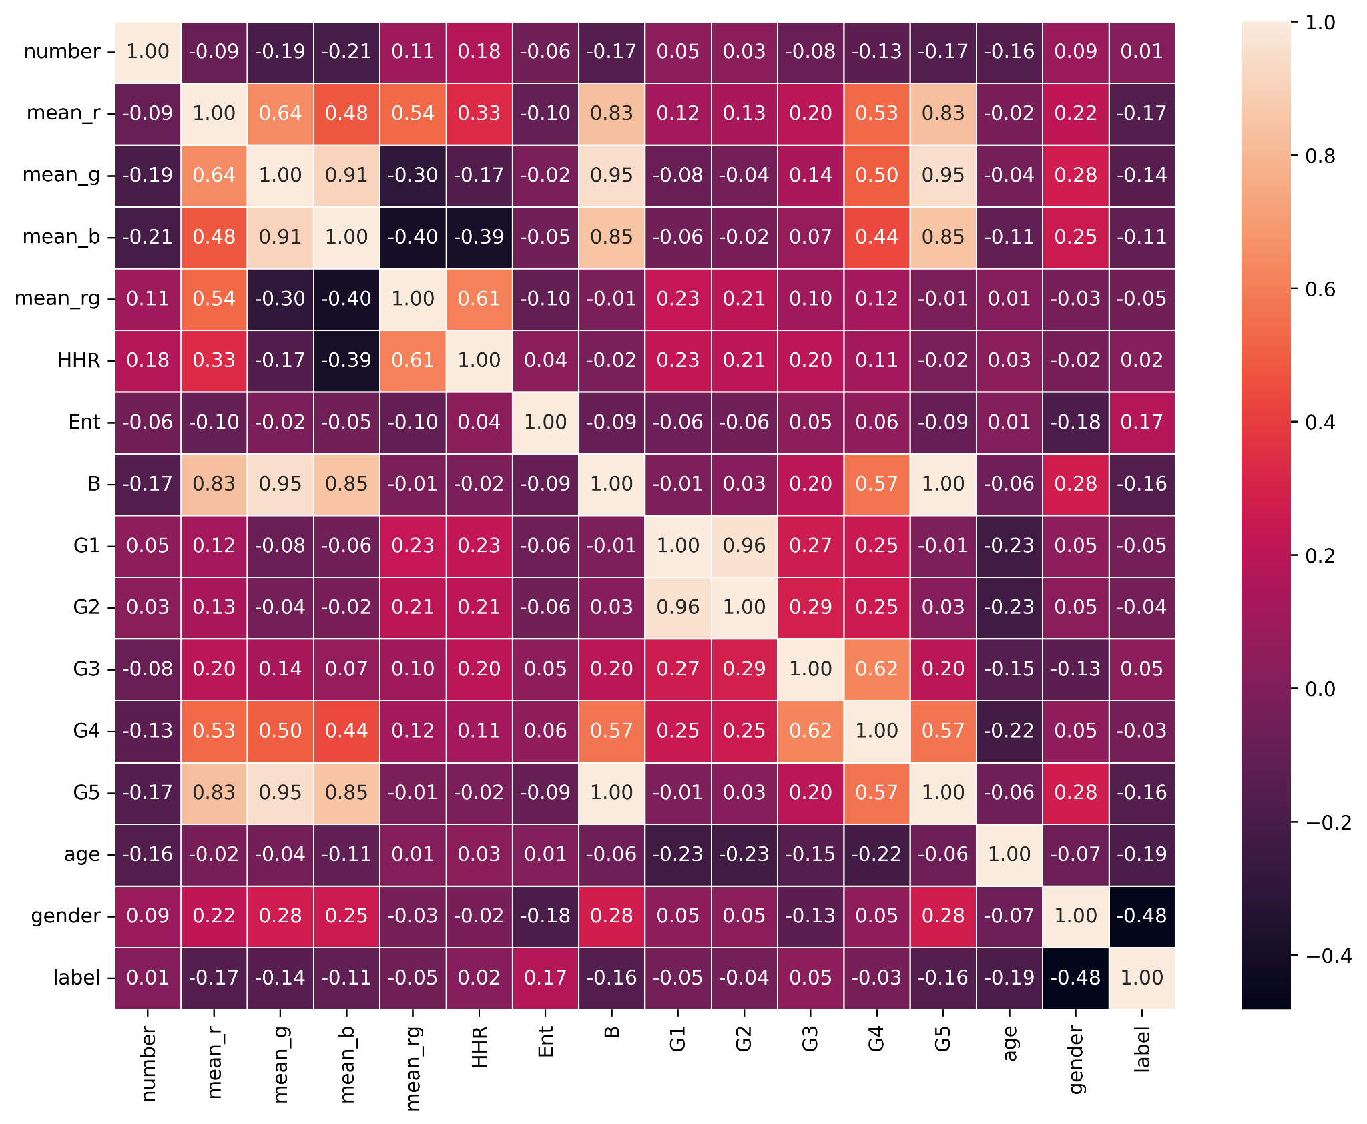
C
O
R
R
E
L
A
T
I
O
N

Slide 12
B
G1
G5
G2
B
mean_g

Slide 13
Upcoming Tasks
Task are according to the priority
Complete all annotations (eye, palm, nail, tongue)
Complete Exploratory Data Analysis
Feature Selection using exploratory data analysis
Regression Models using individual anatomies
Error Analysis for each model
Class-wise accuracy
Combined model using all 4 anatomies and further experimentation with the model

Slide 14
Thank You

